Slide 1
Teams and Team Roles
Software Engineering
Neil Toporski

Slide 2
The Scrum Team
The Scrum Team consists of a
Product Owner
Development Team
Scrum Master
Scrum Teams are self-organizing and cross-functional. Self-organizing teams choose how best to accomplish their work, rather than being directed by others outside the team. Cross-functional teams have all competencies needed to accomplish the work without depending on others not part of the team. The team model in Scrum is designed to optimize flexibility, creativity, and productivity.
Scrum Teams deliver products iteratively and incrementally, maximizing opportunities for feedback. Incremental deliveries of “Done” product ensure a potentially useful version of working product is always available.

Slide 3
The Product Owner
The Product Owner is the sole person responsible for managing the Product Backlog. Product Backlog management includes:
Clearly expressing Product Backlog items;
Ordering the items in the Product Backlog to best achieve goals and missions;
Optimizing the value of the work the Development Team performs;
Ensuring that the Product Backlog is visible, transparent, and clear to all, and shows what the Scrum Team will work on next; and,
Ensuring the Development Team understands items in the Product Backlog to the level needed.
Notes:
+ scrum master don’t do the programming
Get all the requirements of the sponsor (sprint 0)
Make sense w/ them from backlog
Prioritize certain things
Extremely detailed
User stories so they can morph into tasks
Each dev can take certain tasks and start developing
Meet everyday to talk about it
Rearrange the backlog whether you’re meeting the clients’ needs
Relays questions to customer

Slide 4
The Development Team
The Development Team consists of professionals who do the work of delivering a potentially releasable Increment of “Done” (potentially-shippable) product at the end of each Sprint. Only members of the Development Team create the Increment.
Development Teams are structured and empowered by the organization to organize and manage their own work. The resulting synergy optimizes the Development Team’s overall efficiency and effectiveness.
Notes:
First thing as a team → make priorities → scrum backlog → who’s gonna do what

Slide 5
The Development Team
Development Teams have the following characteristics:
They are self-organizing. No one (not even the Scrum Master) tells the Development Team how to turn Product Backlog into Increments of potentially releasable functionality
Development Teams are cross-functional, with all of the skills as a team necessary to create a product Increment
Scrum recognizes no titles for Development Team members other than Developer, regardless of the work being performed by the person ; there are no exceptions to this rule
Scrum recognizes no sub-teams in the Development Team, regardless of particular domains that need to be addressed like testing or business analysis; there are no exceptions to this rule
Individual Development Team members may have specialized skills and areas of focus, but accountability belongs to the Development Team as a whole.

Slide 6
The Scrum Master
The Scrum Master is responsible for ensuring Scrum is understood and enacted. Scrum Masters do this by ensuring that the Scrum Team adheres to Scrum theory, practices, and rules.
The Scrum Master is a servant-leader (but they are not team leaders) for the Scrum Team. The Scrum Master helps (supports) those outside the Scrum Team understand which of their interactions with the Scrum Team are helpful and which aren’t. The Scrum Master helps (supports) everyone change these interactions to maximize the value created by the Scrum Team.
Notes:
Any needs of the team (need something to work collaboratively)
Everyone’s playing well together

Slide 7
The Scrum Master and Product Owner
The Scrum Master serves the Product Owner in several ways, including:
Finding techniques for effective Product Backlog management
Helping the Scrum Team understand the need for clear and concise Product Backlog items
Understanding product planning in an empirical environment;
Ensuring the Product Owner knows how to arrange the Product Backlog to maximize value
Understanding and practicing agility
Facilitating Scrum events as requested or needed.

Slide 8
The Scrum Master and Development Team
The Scrum Master serves the Development Team in several ways, including:
Coaching the Development Team in self-organization and cross-functionality
Helping the Development Team to create high-value products
Removing impediments to the Development Team’s progress
Facilitating Scrum events as requested or needed,
Coaching the Development Team in organizational environments in which Scrum is not yet fully adopted and understood.

Slide 9
The Scrum Master and the Organization
The Scrum Master serves the organization in several ways, including:
Leading and coaching the organization in its Scrum adoption
Planning Scrum implementations within the organization
Helping employees and stakeholders understand and enact Scrum and empirical product development
Causing change that increases the productivity of the Scrum Team
Working with other Scrum Masters to increase the effectiveness of the application of Scrum in the organization.

Slide 10
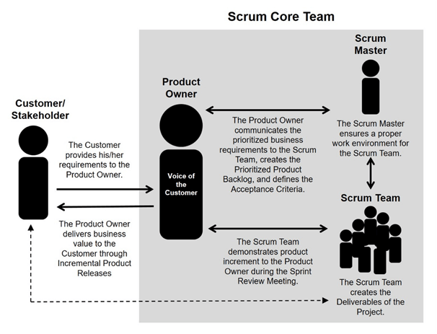
The Team

